Slide 1

Remind & Record
Josna Pitta Sandeep Reddy Veeramalla Vamshi Krishna Reddy Cherukupally

Slide 2
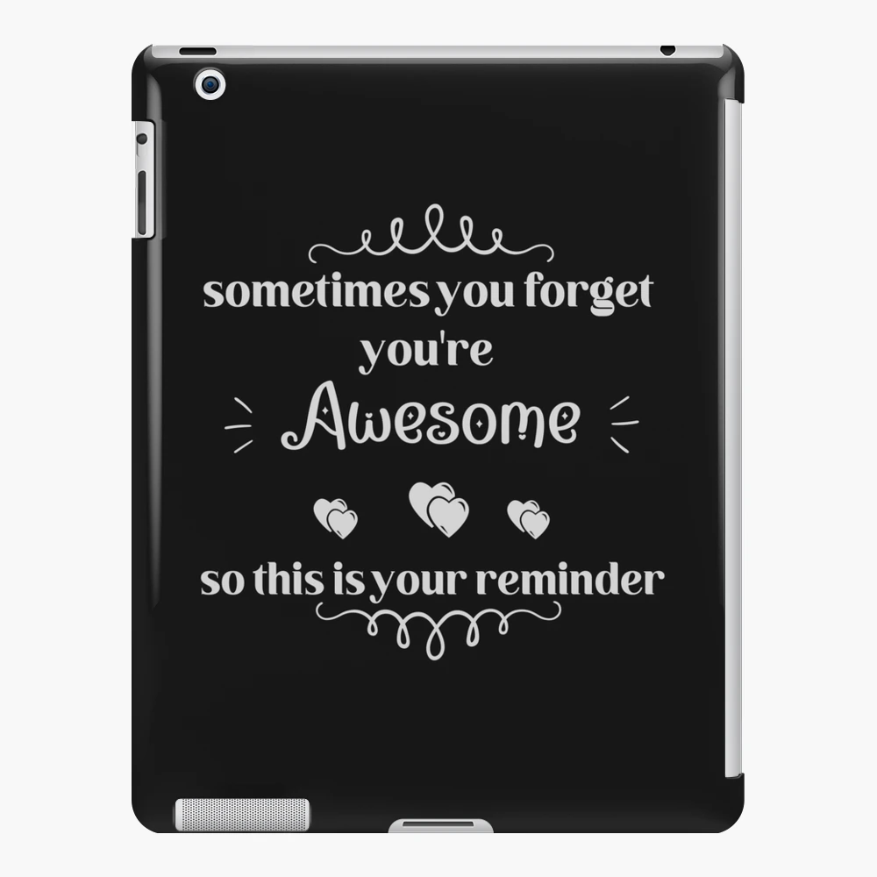
Motivation

Slide 3
Project description
A mobile application to interact with users to remind them about their daily tasks and goals.
It helps to record the progress by asking a simple question.

Slide 4
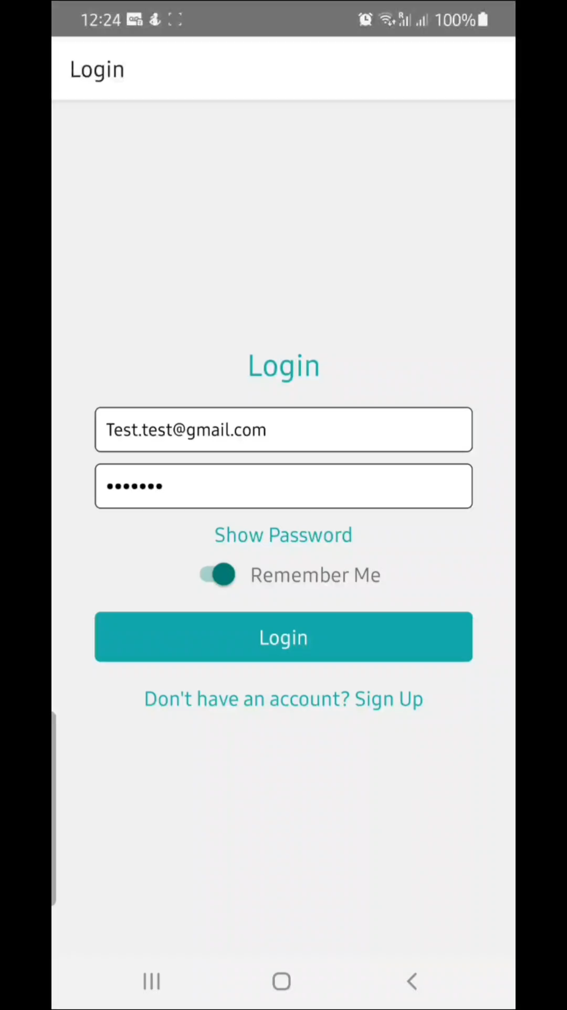

Slide 5
Thank you

